Slide 1
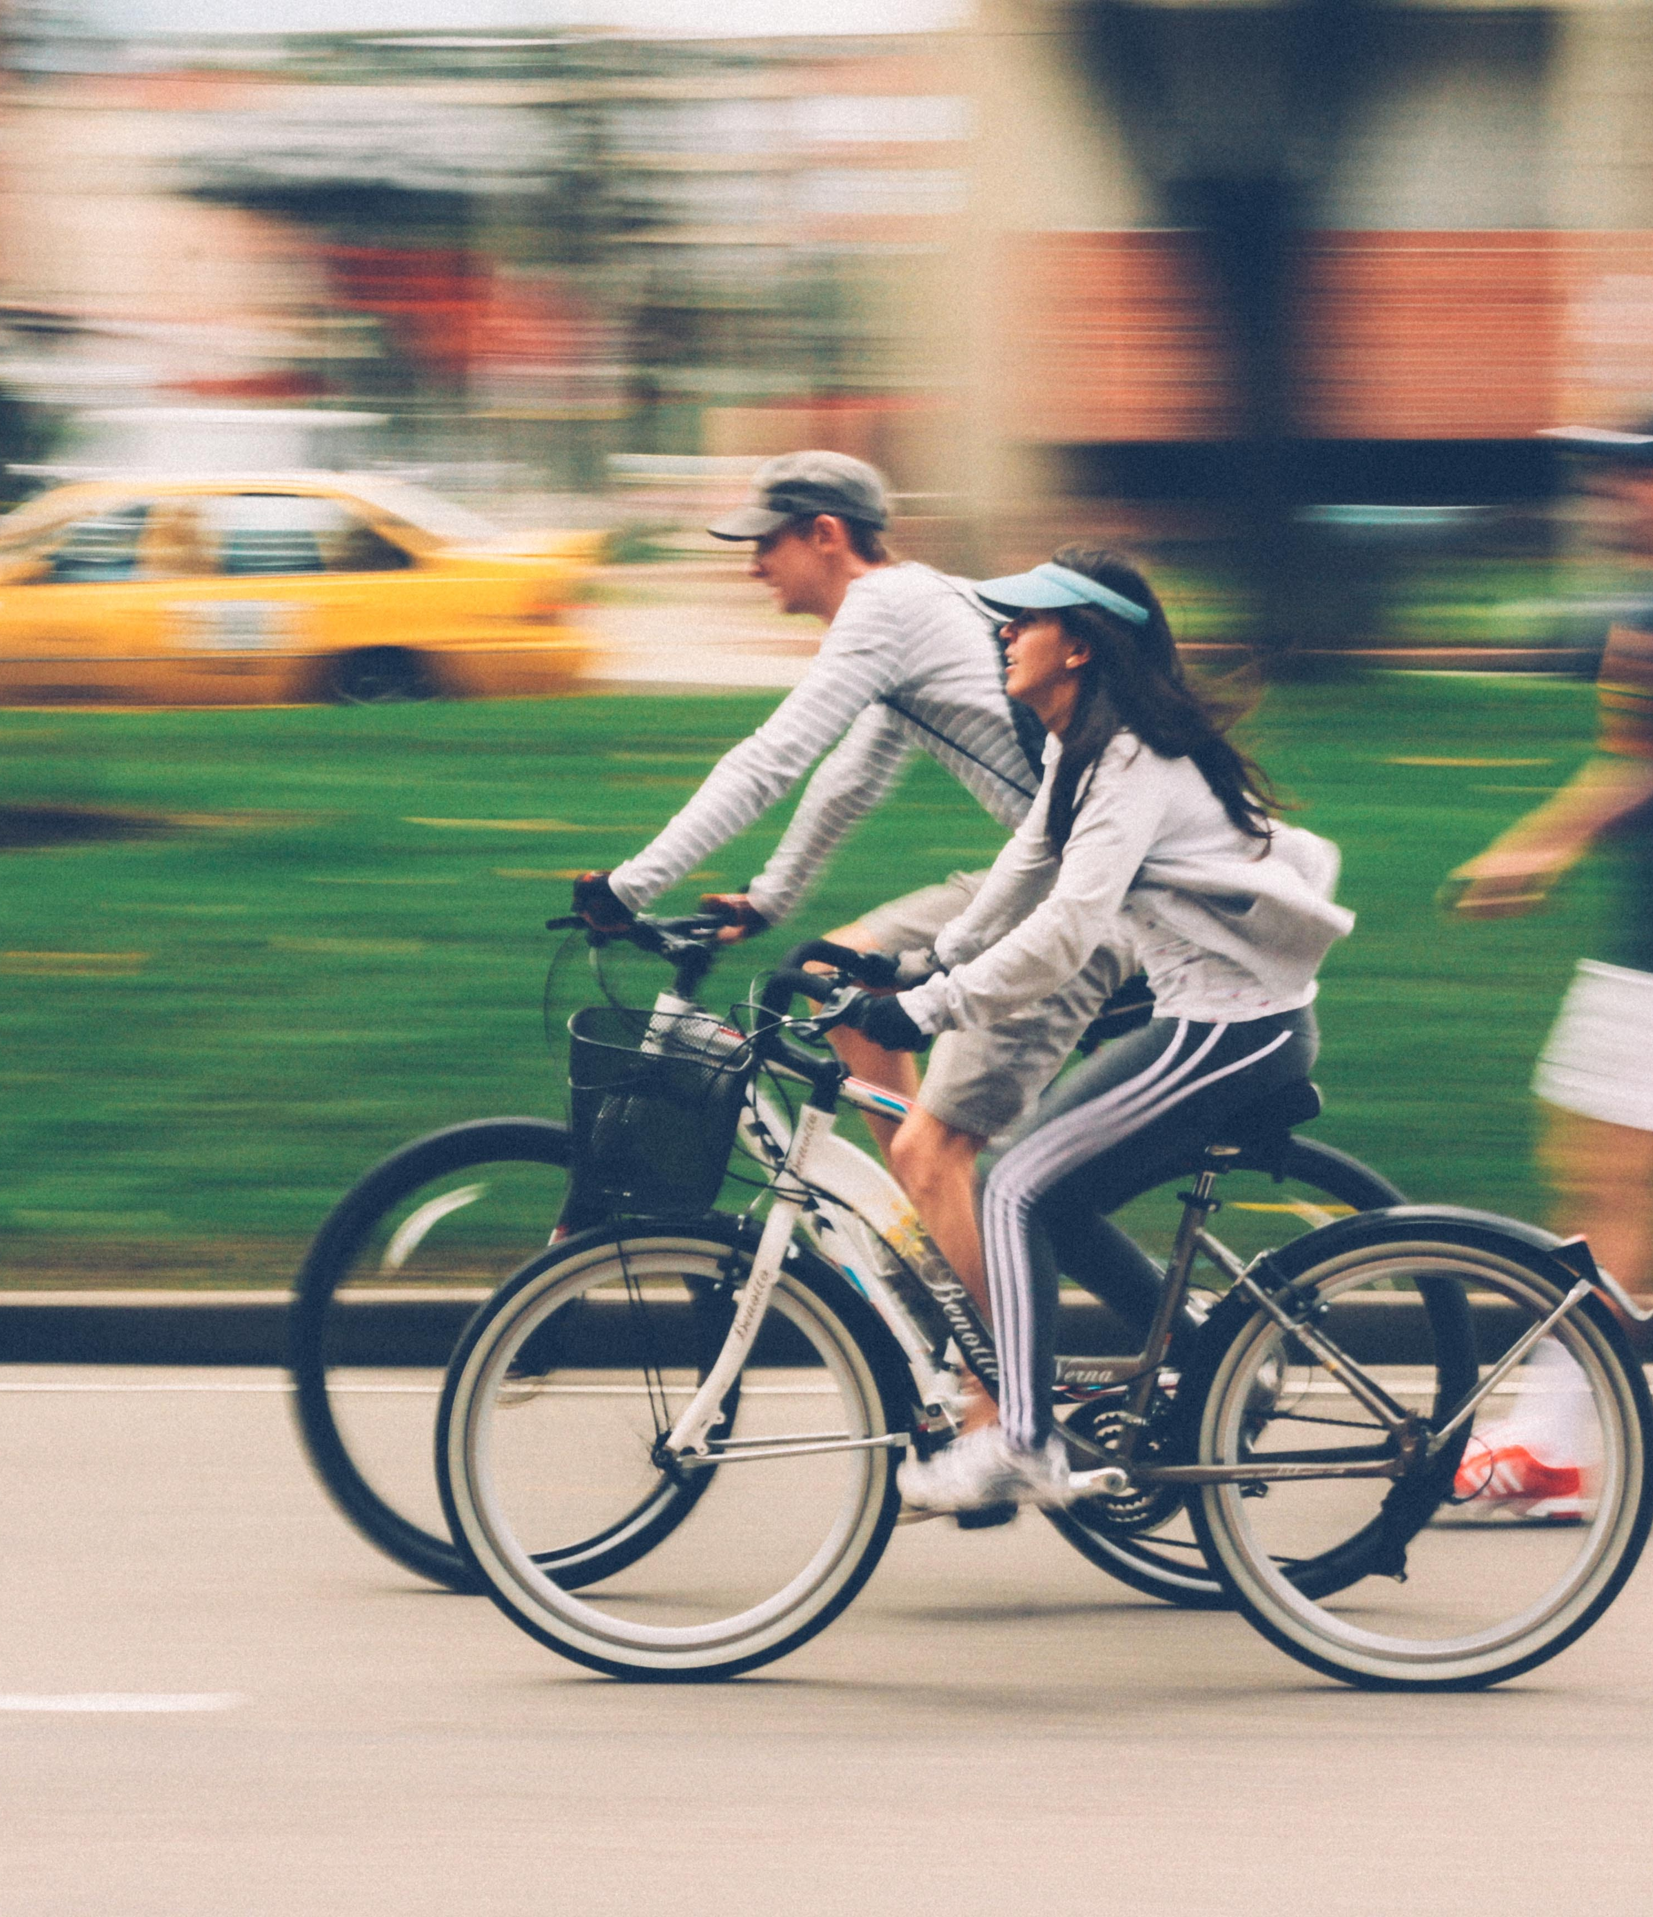
Cyclisitic Rider Data for 2021
Presented by: Dean Carr
November 05, 2022
Data Analysis Team
Notes:
Line spacing + Page numbers

Slide 2
Agenda
01 Introduce Data Set
02 Discus: Members Vs. Casuals
03 Review Data
04 Recommendations
05 Closing

Slide 3
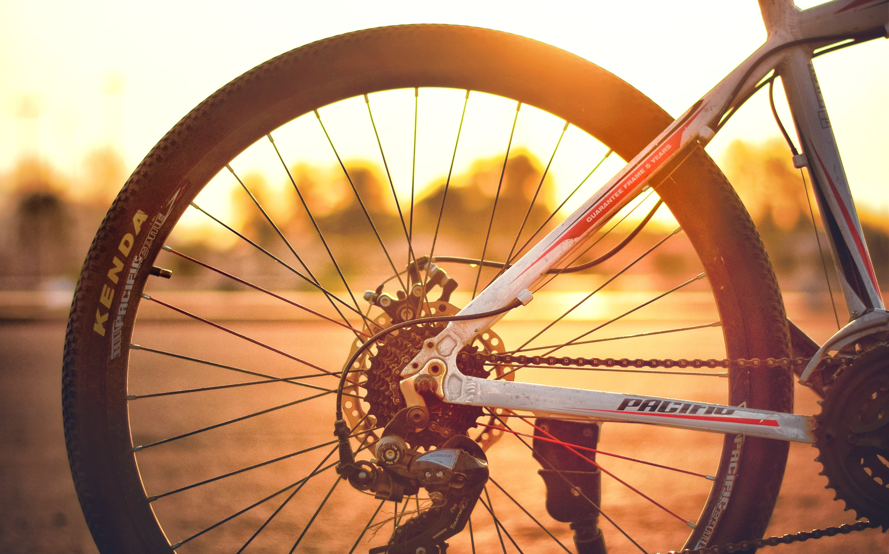
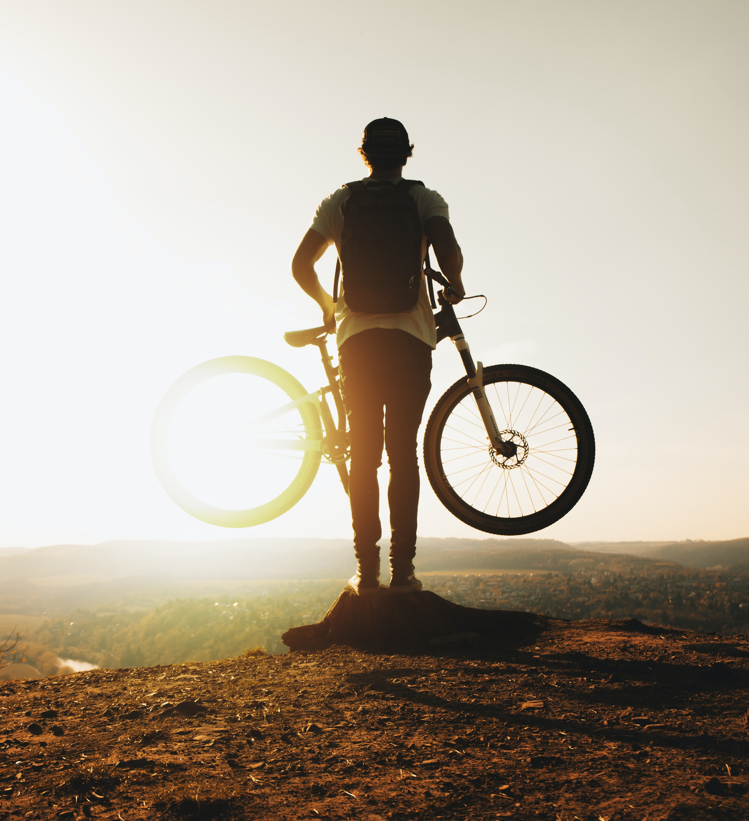
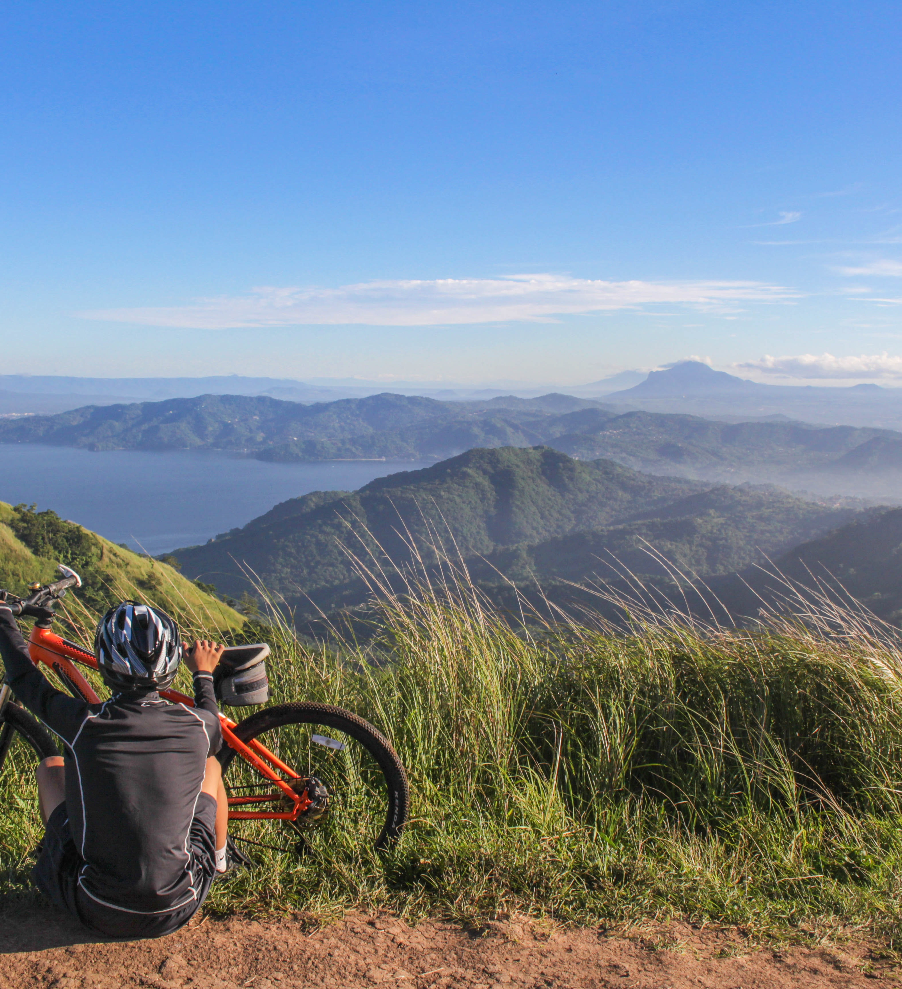
Introduction
01
Our data set is compiled from monthly spreadsheets across all of 2021.
It contains information on both members and casual riders.
Each individual ride.

Slide 4
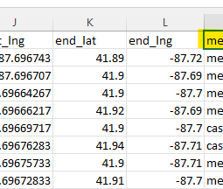
The Raw Data
Excel Sheets
Each row is a ride
  Ride ID
  Type of Bike
  Start/End Station
  Start/End Date & Time
  Start/End Lat & Long Coordinates
  Membership Status
    Member
    Casual

Slide 5
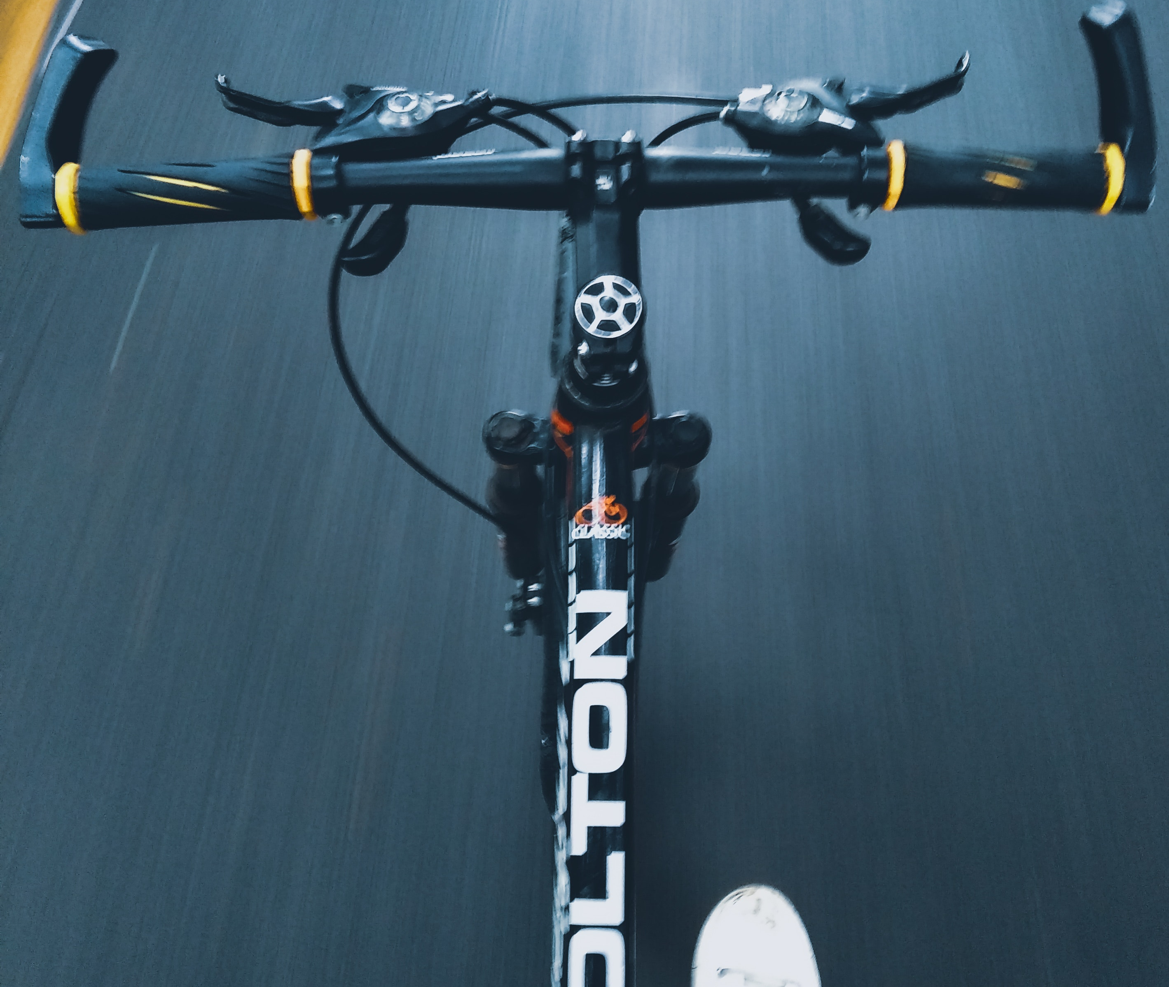
Updates
New column that shows the amount of time that was spent on each ride.
Column for Day of Week ride took place on
Estimated distance traveled
  Taken from start station and end station
  Geospatial, not using street lengths

Slide 6
Presentation Goal
Find out the different ways that Casual riders use our bikes, compared to Members.

Slide 7
Members Vs Casuals
02

Slide 8
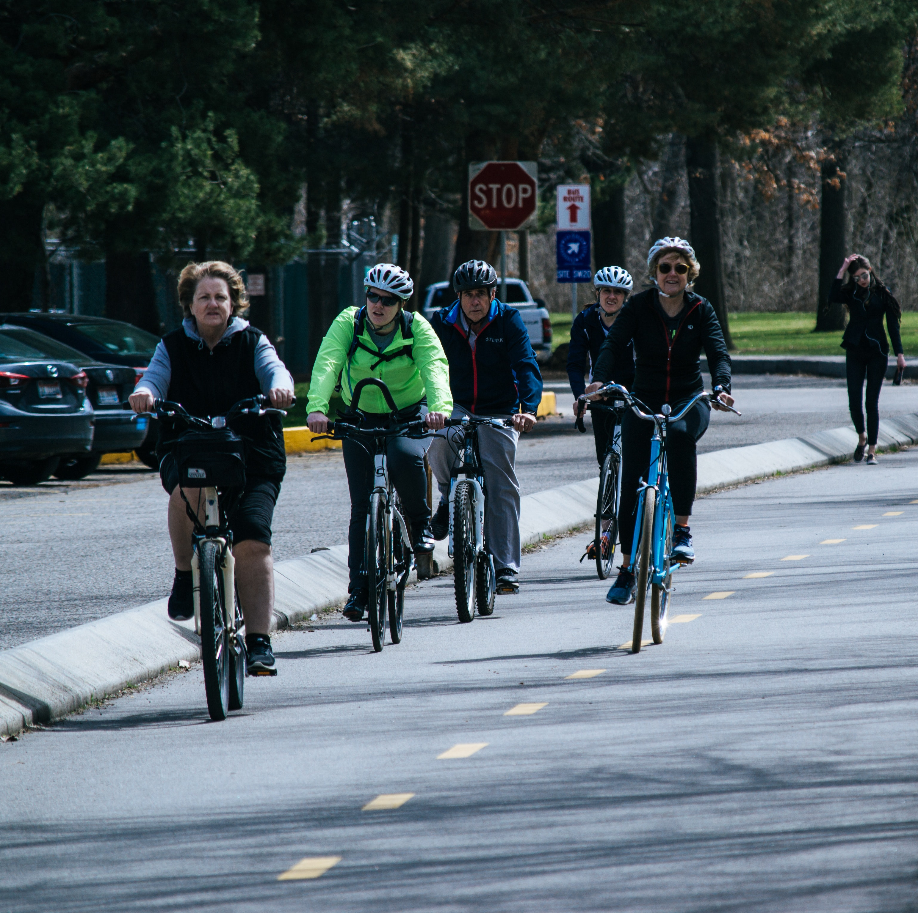
Members
Are paying a monthly subscription for our services.
Deemed the most profitable
Ideal customer

Slide 9

Casuals
Riders who are not subscribed.
Pay at the bike station.
Target demographic
Want to convert to members

Slide 10
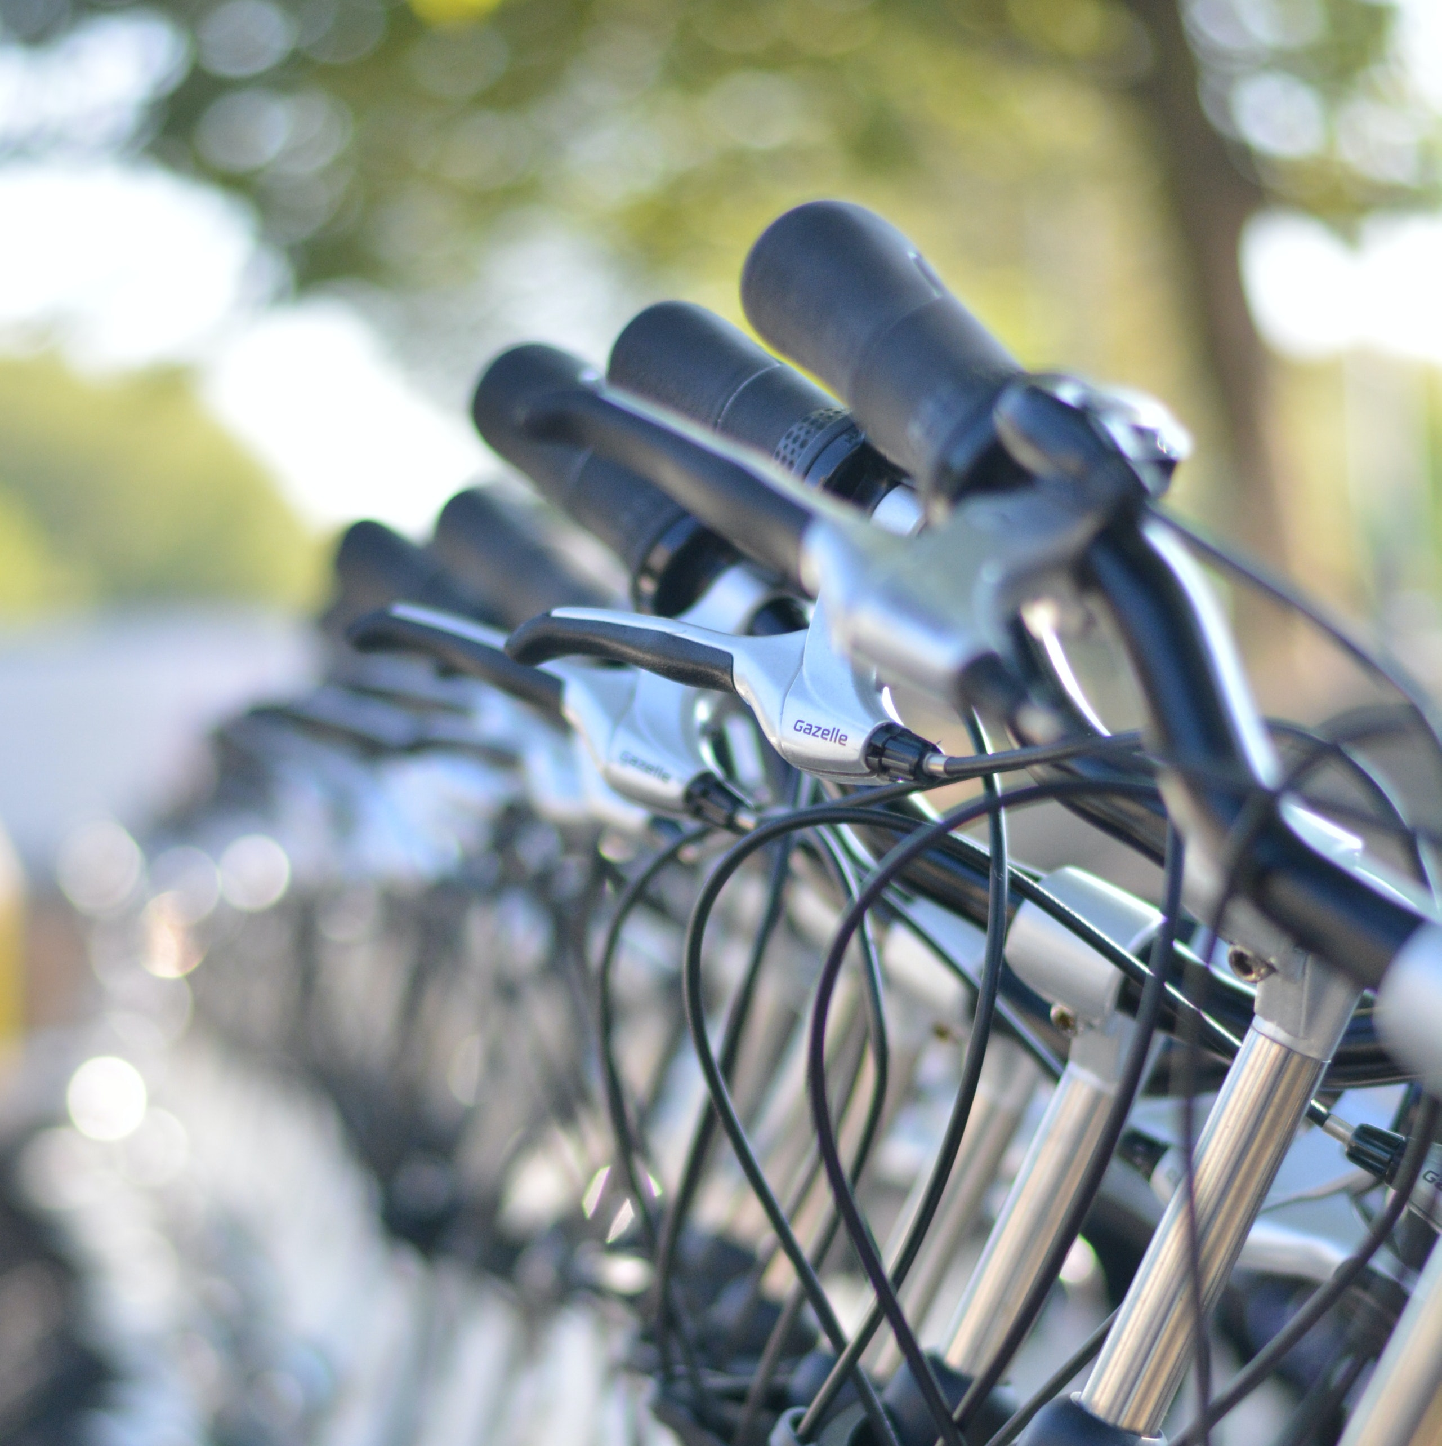

Our Findings
03

Slide 11
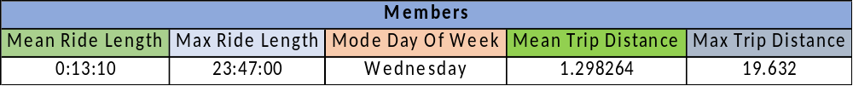
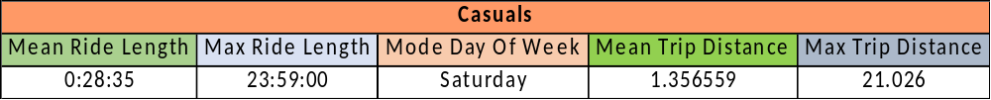
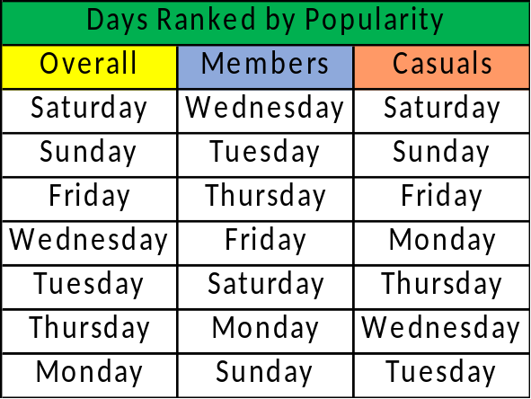
Overview for 2021
By metrics, members and casuals are very similar
Two glaring differences:
Huge difference in ride length (time on bike)
Casuals decided the top 3 days of the week.
Overall
Mean Ride Length | Max Ride Length | Mode Day O fWeek | Mean Trip Distance | Max Trip Distance
0:20:03 | 23:59:00 | Saturday | 1.324289 | 21.026

Slide 12
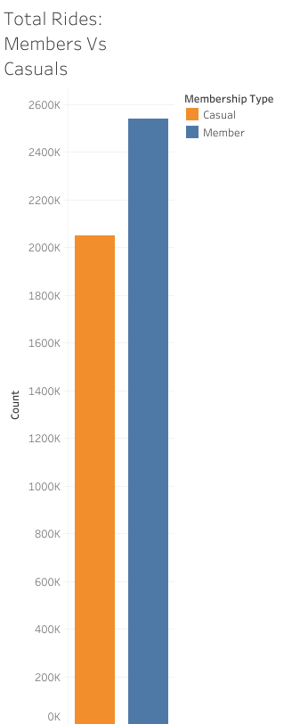
Total # of Rides
There were about 2 million casual rides in 2021
Compared to over 2.5 million member rides

Slide 13
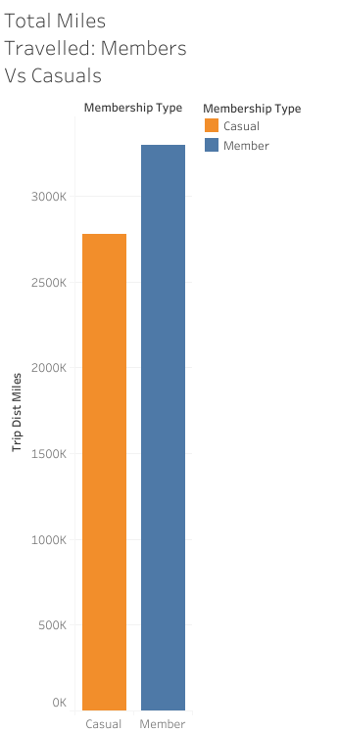
Total # of Miles
Miles tell a similar story
Members trail ahead by over 100k miles
Note: Distance is calculated by start and end stations

Slide 14
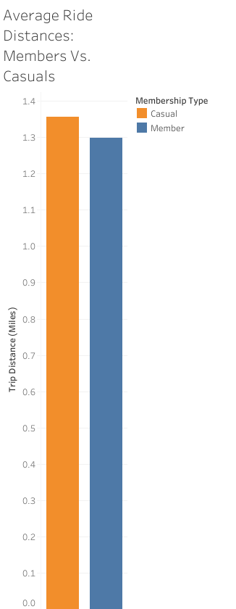
Average Ride Distance
Here is where the Casual riders start to take the lead
On average, Casuals travel a bit further than Members

Slide 15
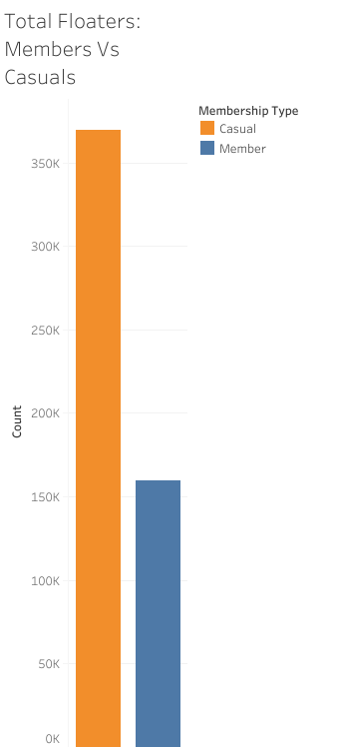
Floaters
People who return their bikes to the same starting station.
Casuals shine here, with well over twice as many of them staying in the area where they picked up their bikes .

Slide 16
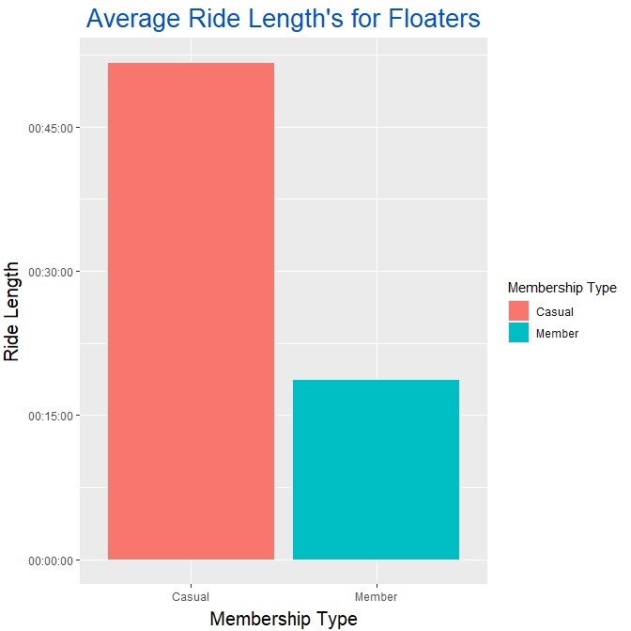
Floaters cont.…
Average time spent ratio is nearly identical to total rides
Casuals spend 2.5x the time with their bikes.

Slide 17
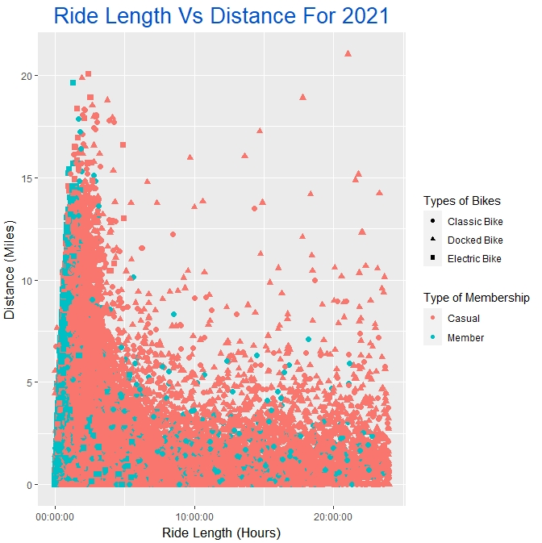
Ride Distance Vs Time Length
Members tend to spend less time on their rides
Casuals branch out on the time scale, taking up the longer times for a given distance
Reminder: There are more Member rides than Casual.

Slide 18
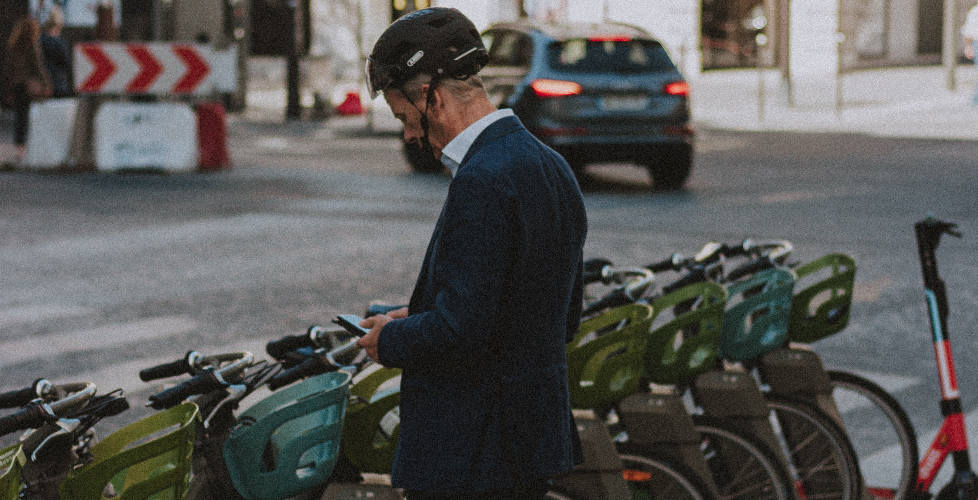

Cont.….
Members seem to use bike as more of commute.
Casuals seem to be using bikes more recreationally.
  Spend longer time at any distance
  Are the majority of Floaters

Slide 19
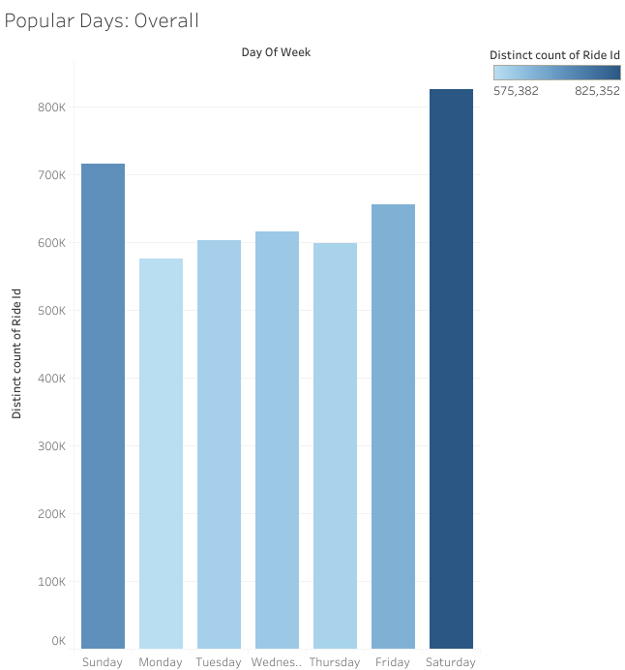
Popular Days
The Weekends are the most popular
Supports the idea of leisure being the strongest driver for ride numbers

Slide 20
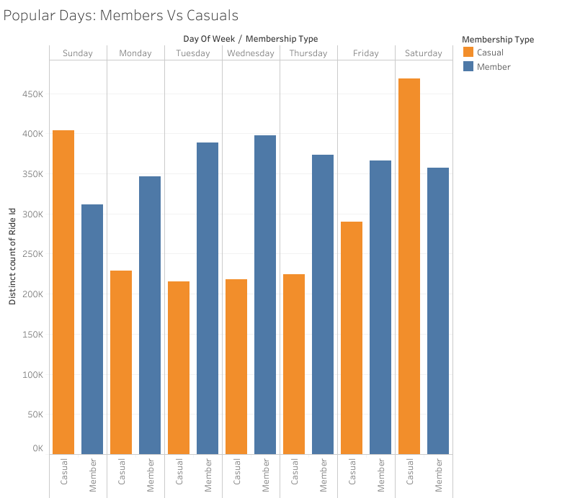
Members Vs Casuals
During week, members have the higher numbers.
On weekends, Casuals bring in the highest numbers of the whole week.

Slide 21
Recommendations
04

Slide 22
Leisure Activity
Casual riders are more likely to be using our bikes as a recreational activity, or to help them get around for recreation.
A strategy centered on making membership a more fun experience.
Offer incentives towards becoming a member for people who would only use bikes on leisure days.

Slide 23
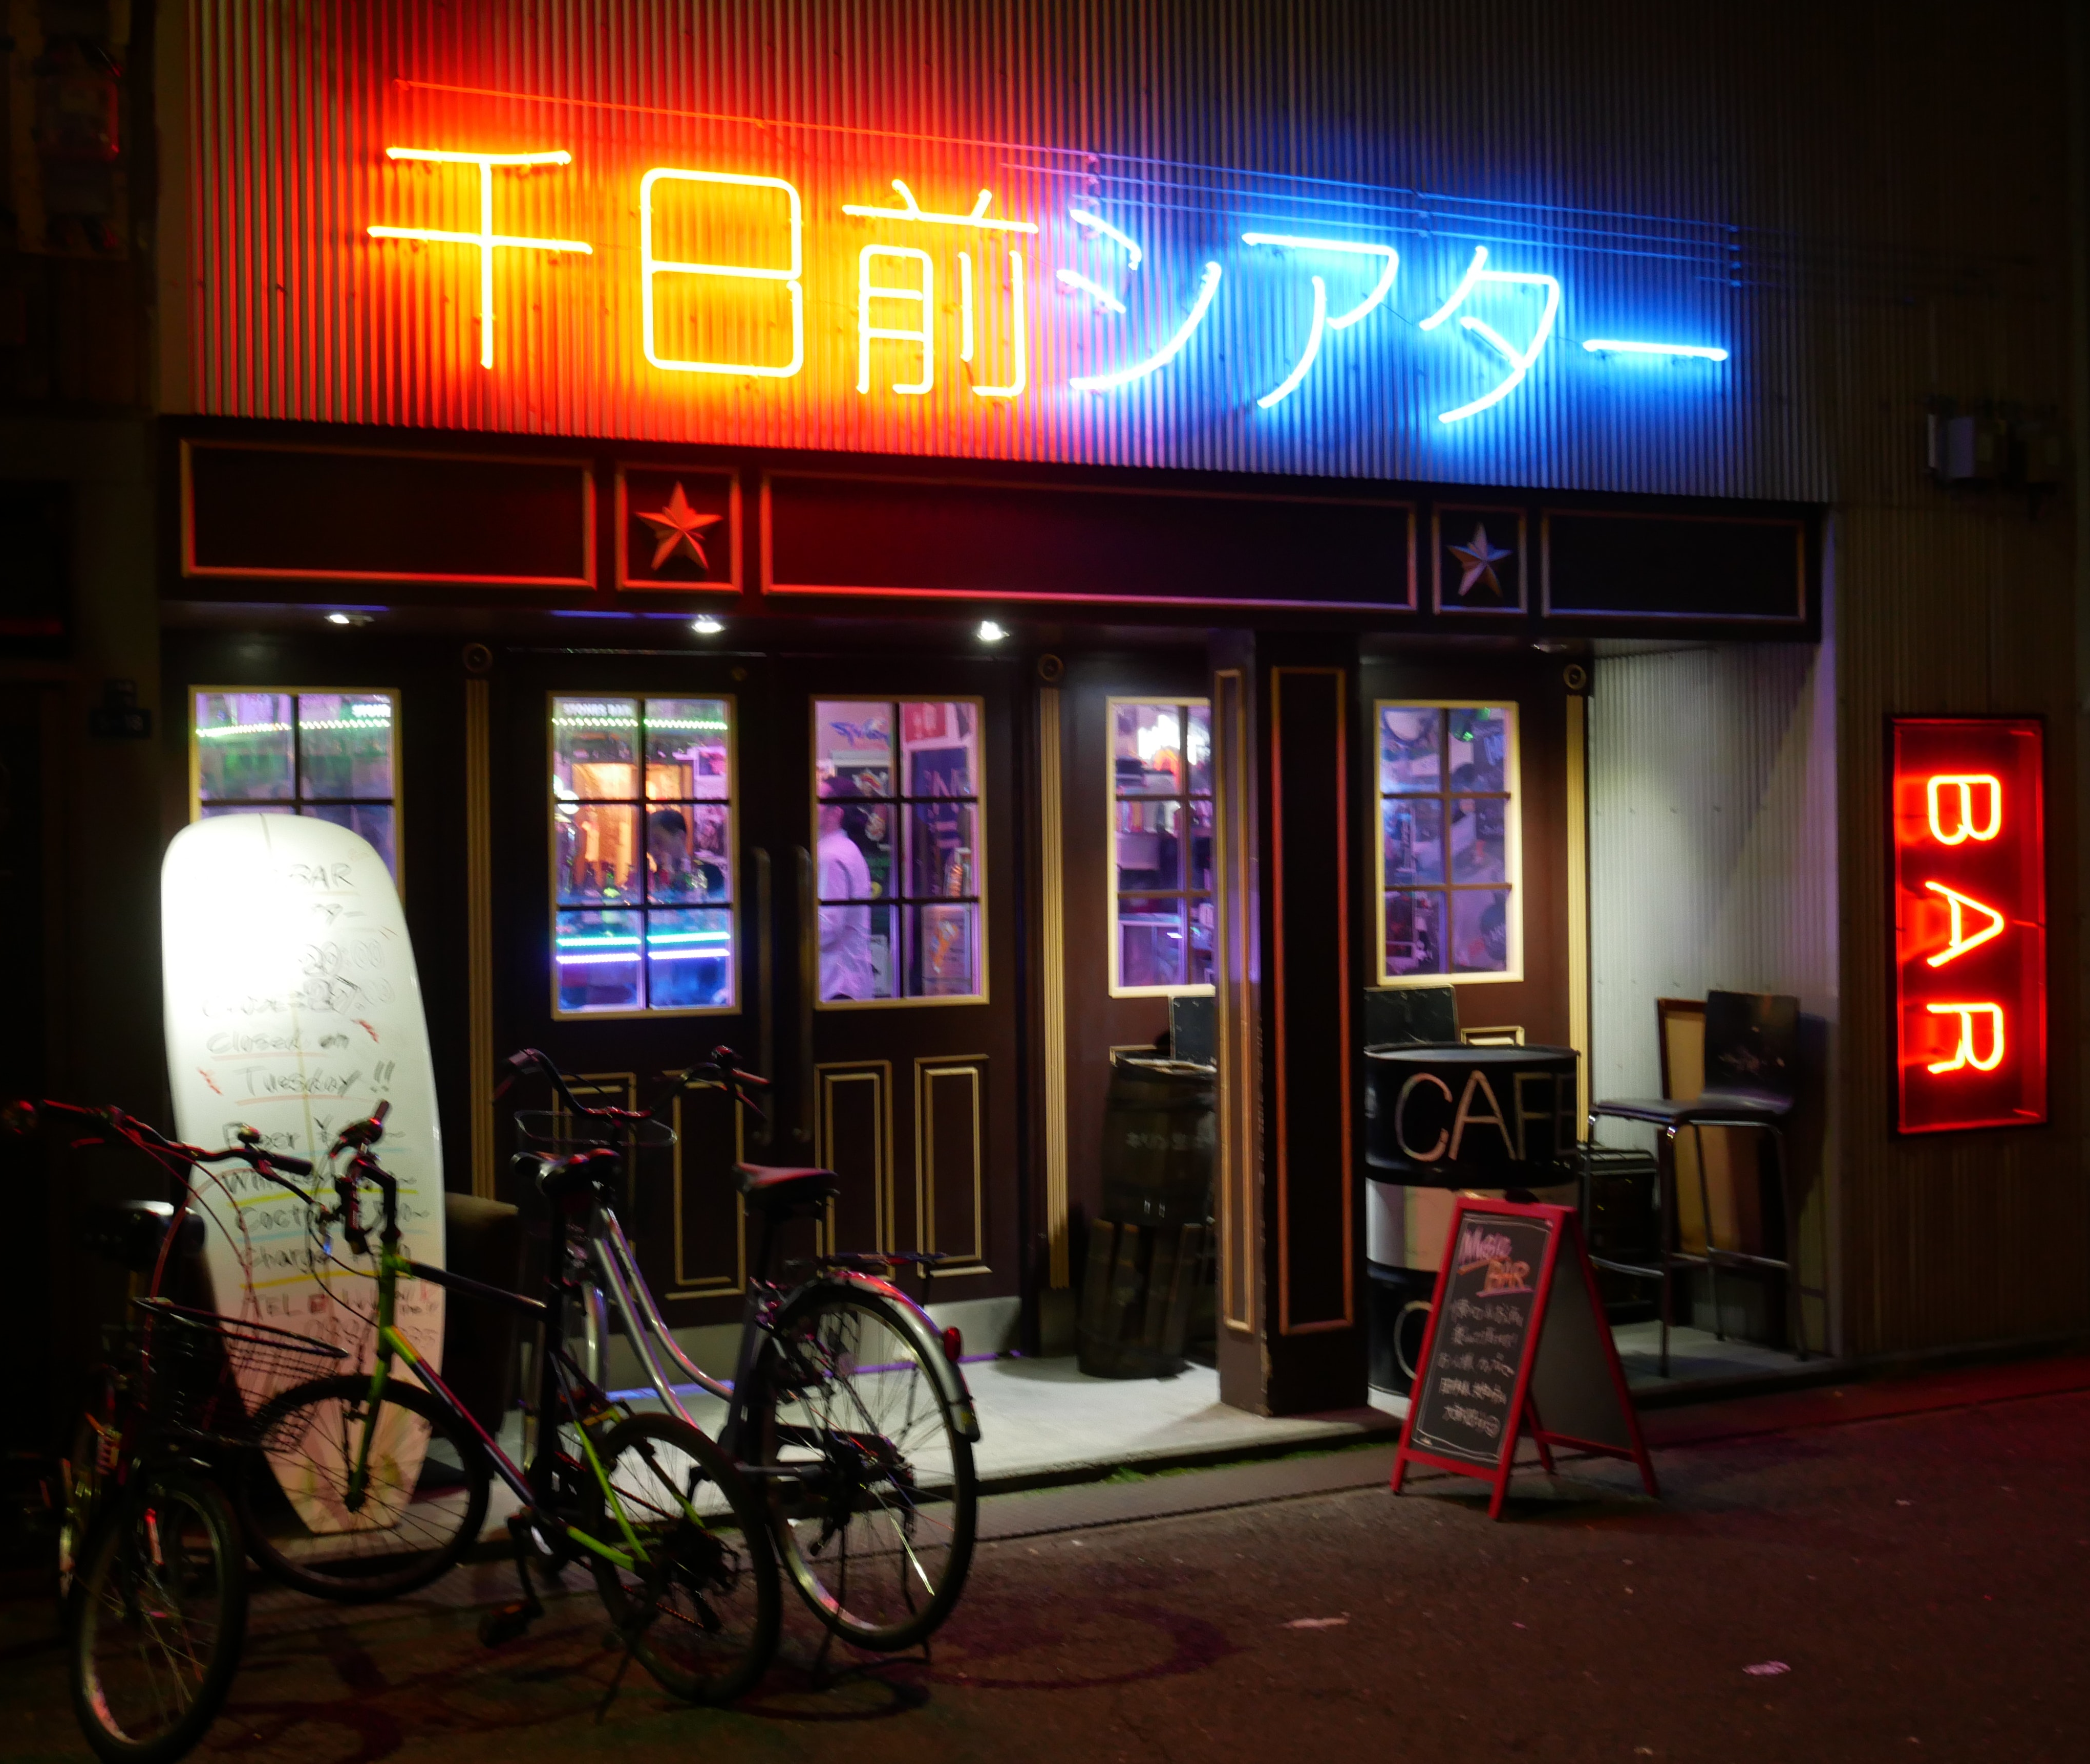
Discounts/Rewards
Offer discounts at local establishments for Members.
Rewards points system.
  Redeemable rewards for longer rides, more days, etc.

Slide 24

Social Media Engagement
Challenges
Photo scavenger hunts
Most aesthetic selfies with bikes
Offer Prizes
Cash Prizes to winners
Discounts
Gift Cards\Items
Rider Promotion
Share rider’s posts through our social platforms
Bring more attention to their accounts, pages, and channels

Slide 25
Local Events
Host local events that are free for Members. | Generates good will from our company in the community
Concerts that promote local artists and talents. | Can be done alongside other recommendations
Jobs fairs and small carnivals | Is good promotion for our brand & services

Slide 26
Closing
05
Casual riders are looking for fun more than a mode of commuting.
Base strategy on leisure activities
Questions?
Dean
dcarr@cyclistic.com

